Slide 1

EER DIAGRAM demonstrating generalization and specialization with a University case study
CSA0503 - Database Management Systems
GUIDED BY:
Dr. J. RUBY ELIZABETH
SUBMITTED BY:
SOBITHA D
192571046

Slide 2
INTRODUCTION
He Enhanced Entity Relationship (EER) model is an extension of the traditional ER model used in database design. It provides advanced concepts such as :
Generalization
Constraints
Specialization
Aggregation
Inheritance

Slide 3
Entities in university system
Person
Student
Faculty
Professor
Assistant Professor
UG Student
PG Student

Slide 4
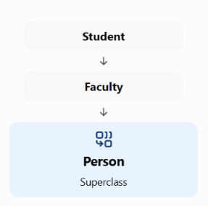
GENERALIZATION CONCEPT
Generalization is the process of combining multiple lower-level entities that share common attributes into a single higher-level entity called a superclass.
University cases:
Common Attributes of Person:
Person ID
Name
Address
Phone
PURPOSE:
avoids repeating common attributes in Student and Faculty tables.

Slide 5
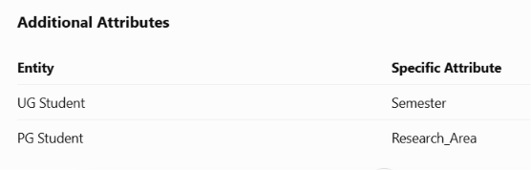
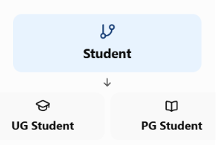
SPECIALIZATION CONCEPT
Specialization is the process of dividing a higher-level entity (superclass) into lower-level entities (subclasses) based on specific characteristics.
University cases:
Benefits:
Stores detailed information
Improves organization

Slide 6
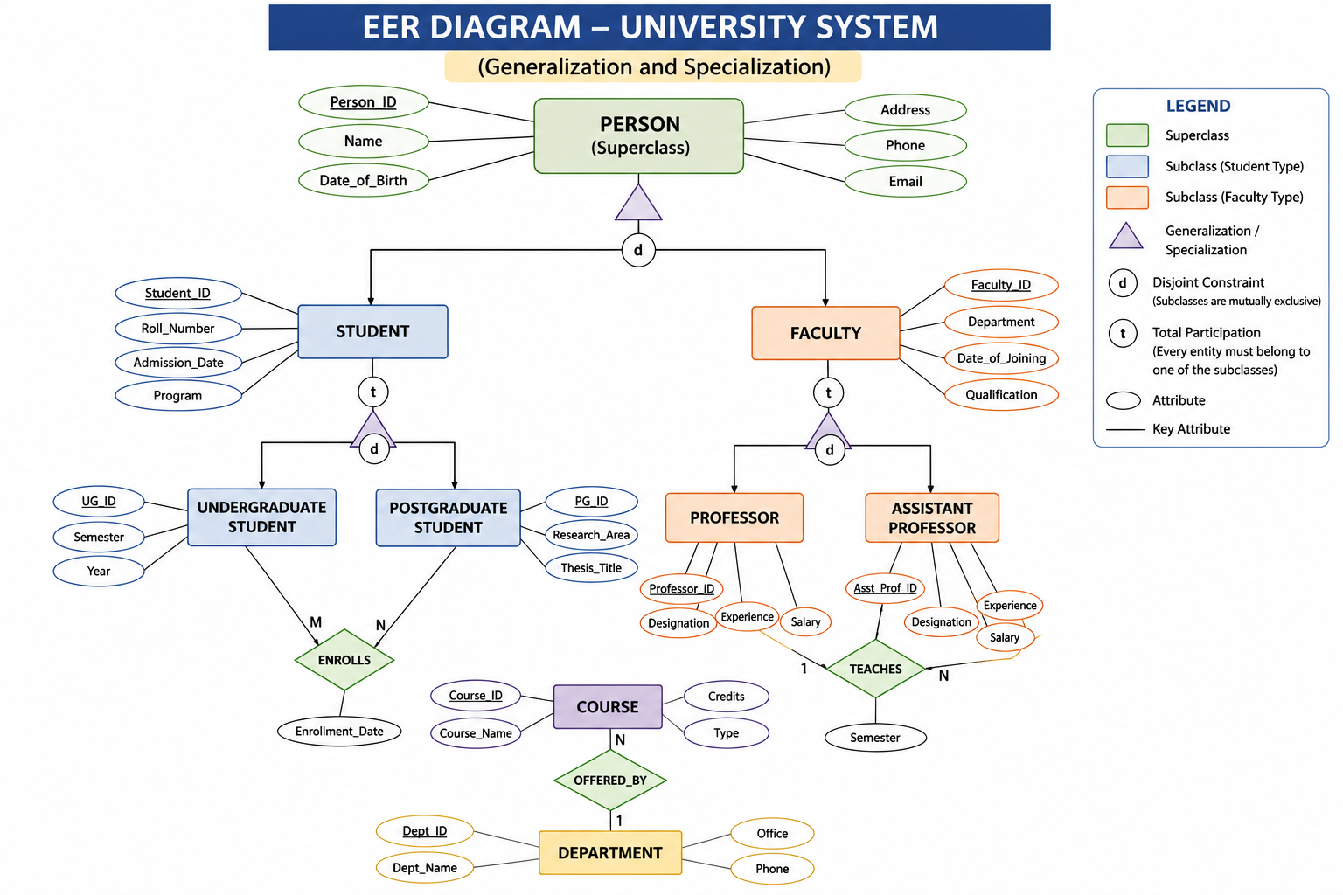

Slide 7
Constraints in Specialization
Disjoint Constraint:
A student can be either UG or PG, not both.
Total Specialization:
Every Student must belong to one specialization.
Partial Specialization:
A Faculty member may or may not be categorized as Professor or Assistant Professor.

Slide 8
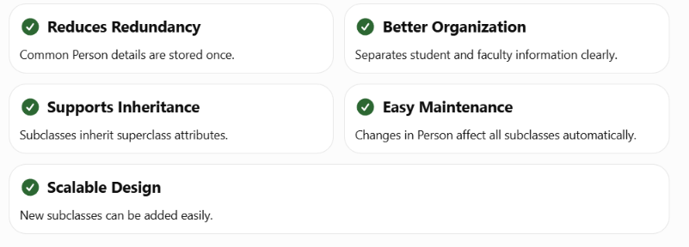
ADVANTAGES

Slide 9
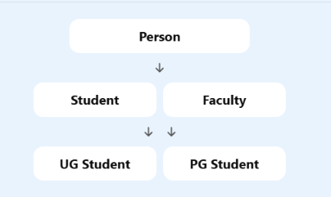
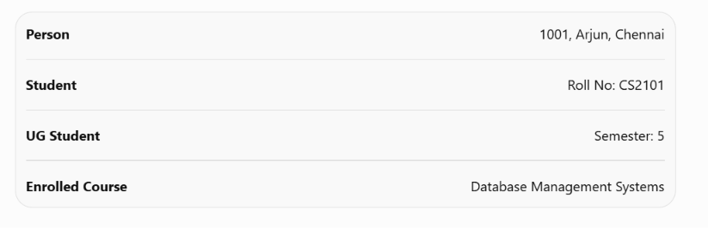
EER DIAGRAM
Real-Time Example

Slide 10
CONCLUSION
EER extends the traditional ER model.
Generalization combines entities into a common superclass.
Specialization creates detailed subclasses from a superclass.
The University case study demonstrates inheritance and hierarchical relationships effectively.
EER models improve data consistency, scalability, and maintainability.

Slide 11
THANK YOU

